Slide 1
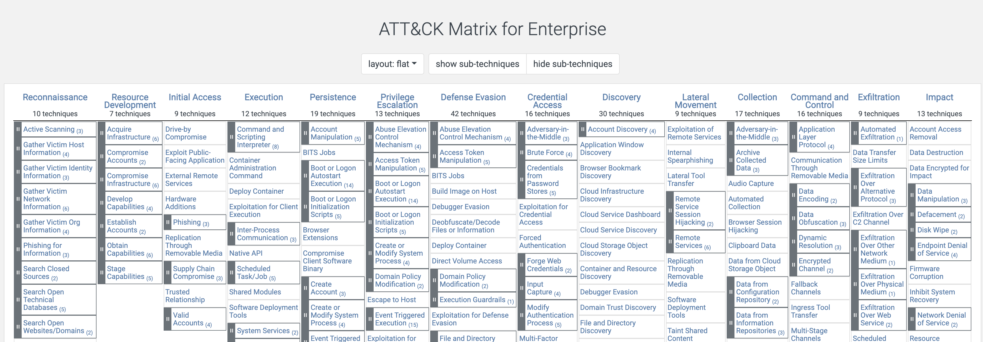
MITRE ATT&CK
https://attack.mitre.org/
Today we will be looking at Initial Access.

Slide 2
Initial Access

Slide 3

A Simplified Look at Initial Access
What is the goal of this phase?
Gain initial access / a foothold into the environment, from which they can expand.
What are the basic high-level categories?
Common:
Attacking internet facing systems, services, and accounts.
Attacking users via phishing or malware.
Social engineering.
Purchasing of valid accounts or access.
Also can include:
Supply chain compromise.
Replication via removable media to reach air-gapped systems.
Insider threat / trusted relationship.
Hardware compromise / hardware additions
This Photo by Unknown Author is licensed under CC BY-NC-ND

Slide 4

A few common scenarios (user)
User clicks a link
(phishing or malware)
User opens an attachment
(malware or obscured link)
User visits a web site that is serving up malware
(drive by download or malvertising)
User clicks a link and approves access to malicious app
(OAuth Phishing)
This Photo by Unknown Author is licensed under CC BY-NC-ND

Slide 5

A few common scenarios (not-user)
Attack a web application
(see OWASP)
Attack a running service or OS flaw
(see Nessus, Metasploit, etc.)
Authenticate to an exposed account
(buy credentials, default creds, brute force, etc.)
This Photo by Unknown Author is licensed under CC BY-SA

Slide 6
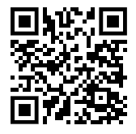

Social Engineering
Convince user to take an action
MFA push or bypass
Gain access to a secure facility under a pretext
This Photo by Unknown Author is licensed under CC BY-NC-ND

Slide 7
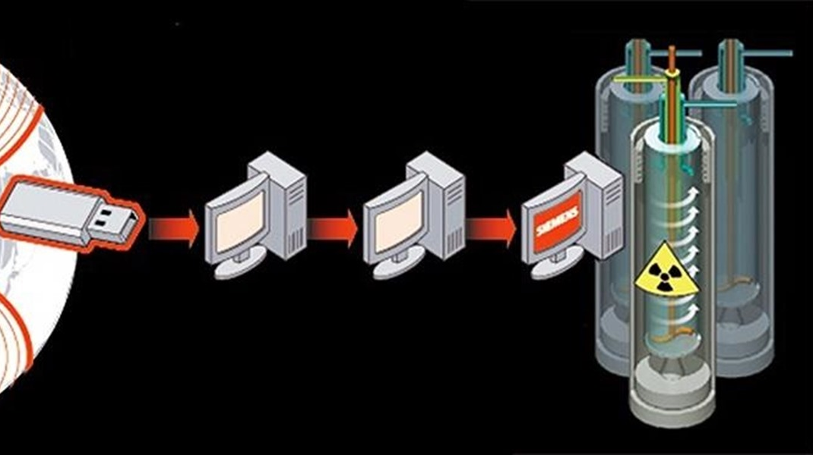
A few other ways to consider
Supply-Chain
(hardware or software)
Complex hybrid combinations
(e.g., phishing + MFA push, etc.)
Playbooks to compromise OT/air gapped networks
Complex malware intended to cross the gap (Stuxnet)
USB or peripheral hardware poisoning (see both Supply-Chain and Social Engineering)
This Photo by Unknown Author is licensed under CC BY-NC-ND

